Slide 2
Mitchell Williams
FINAL YEAR PROJECT PRESENTATION

Slide 3
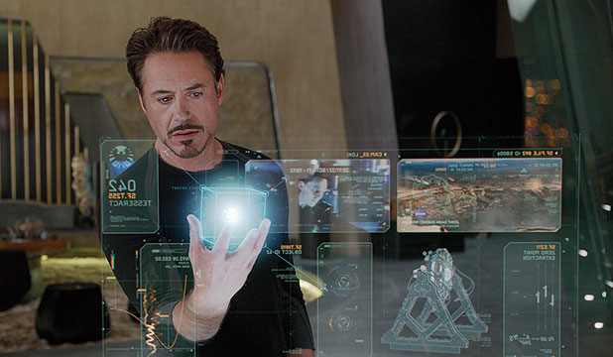
THE GOAL
Real-time hand gesture control of a virtual object in augmented reality

Slide 4
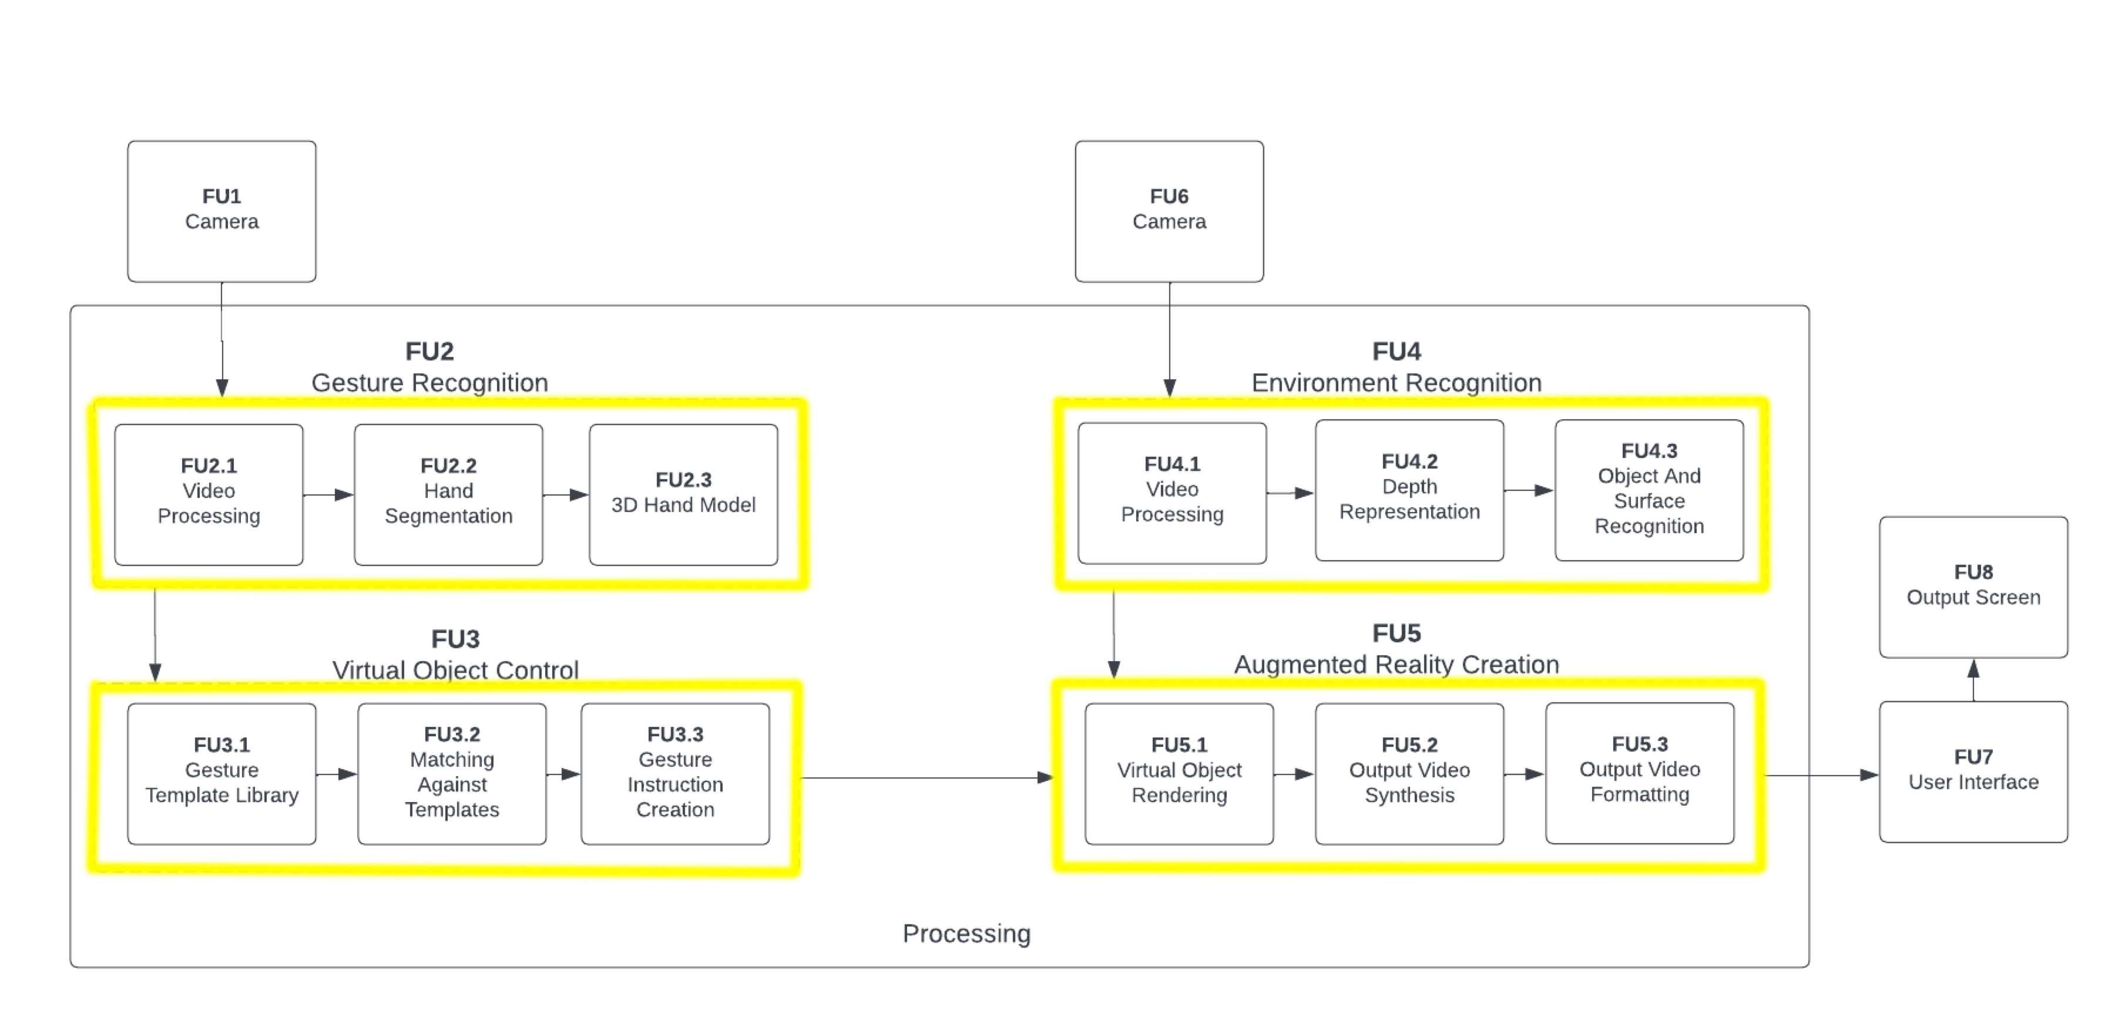
Proposed solution

Slide 5
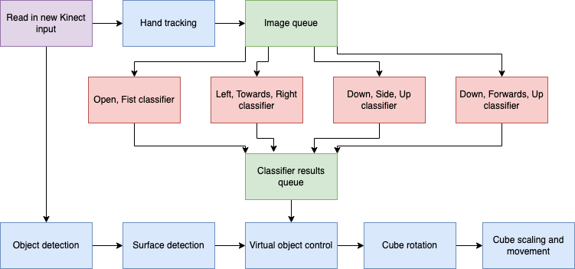
solution

Slide 6
Results
spec 1: 24FPS operation ✅
Spec 2: identify 9 gestures ✅
Spec 3: render and move cube correctly ✅
Spec 4/5: surface and object detection ✅
PC ✅
Embedded ❌

Slide 7
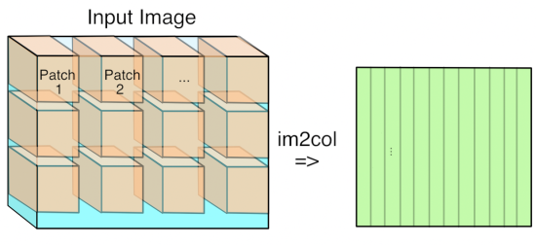
Significant technical challenges
Speed of gesture inference
Optimisations and tradeoffs

Slide 8
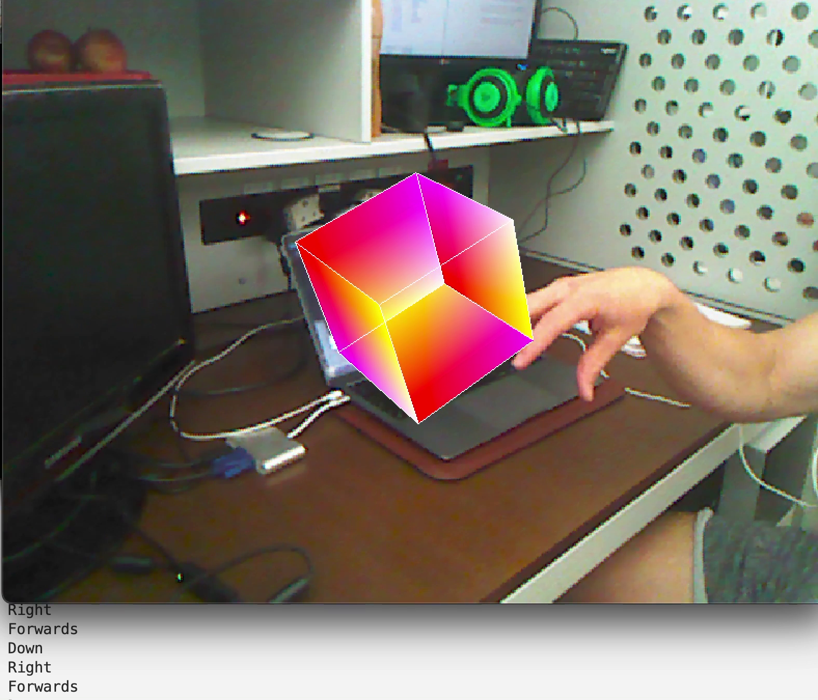
Significant technical challenges
Gesture differentiation
Tradeoff speed vs accuracy

Slide 9
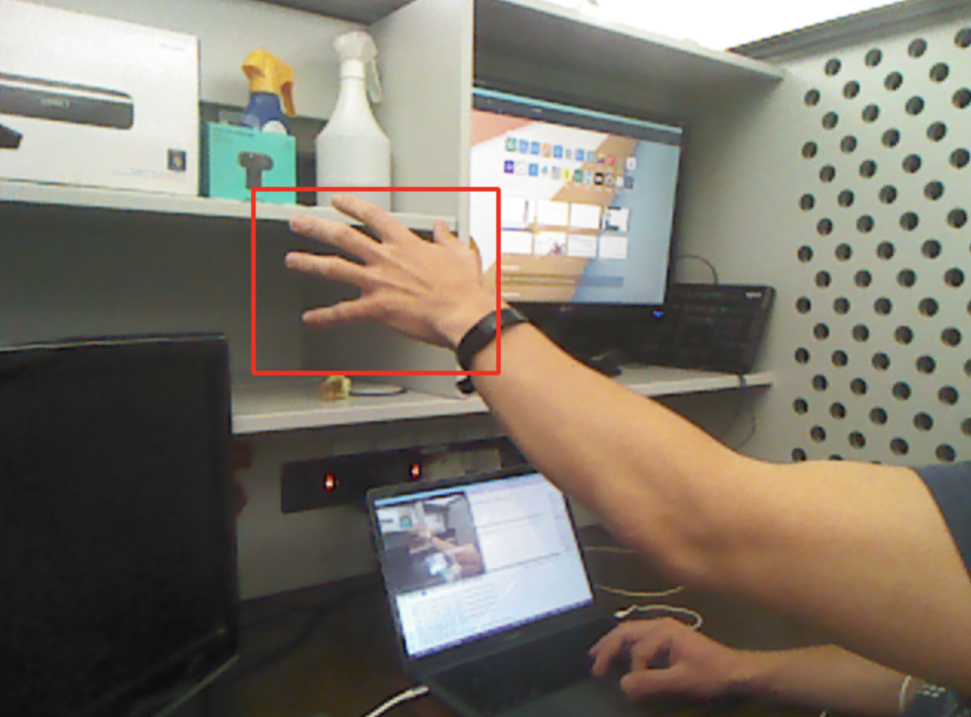
Significant technical challenges
Hand tracking
Accurate bounding

Slide 10
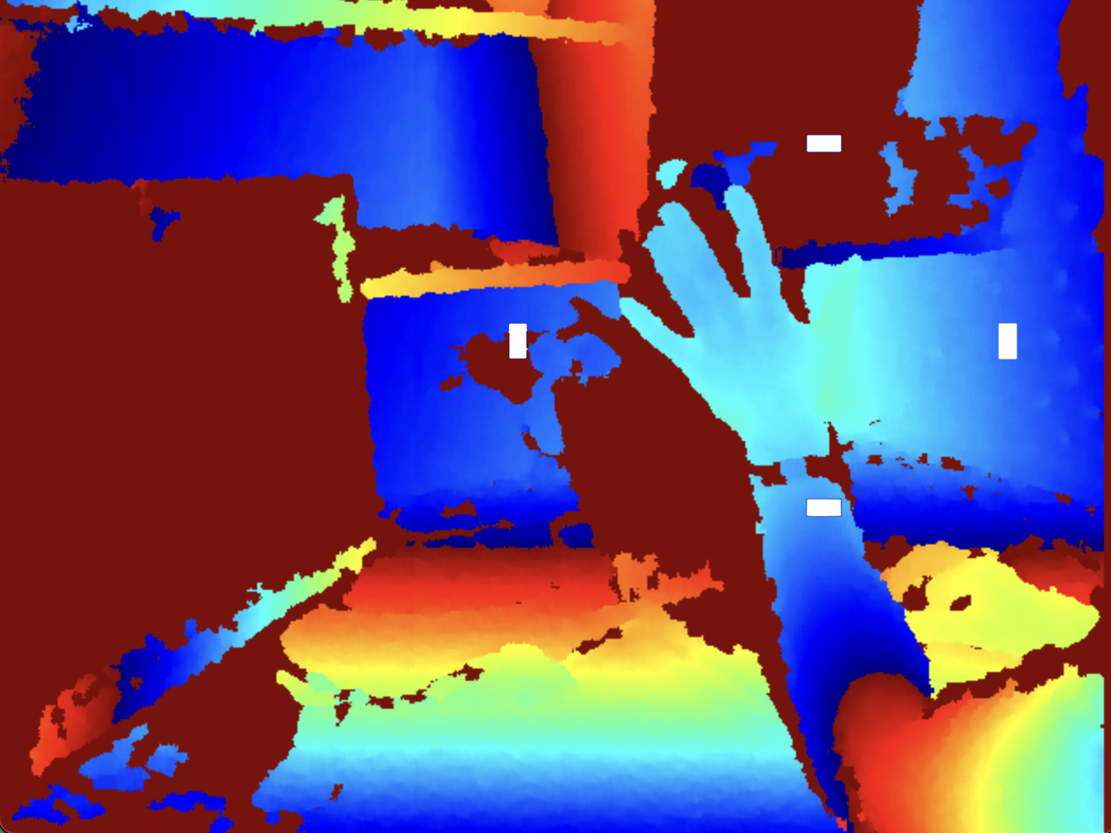
Significant technical challenges
Real world interaction
Z-dimension + bounding boxes

Slide 11
Changes
Clear rotation history (3.5k)
Larger hand candidate regions
largest region close to edge
Different conditions of rotate/move cube

Slide 12
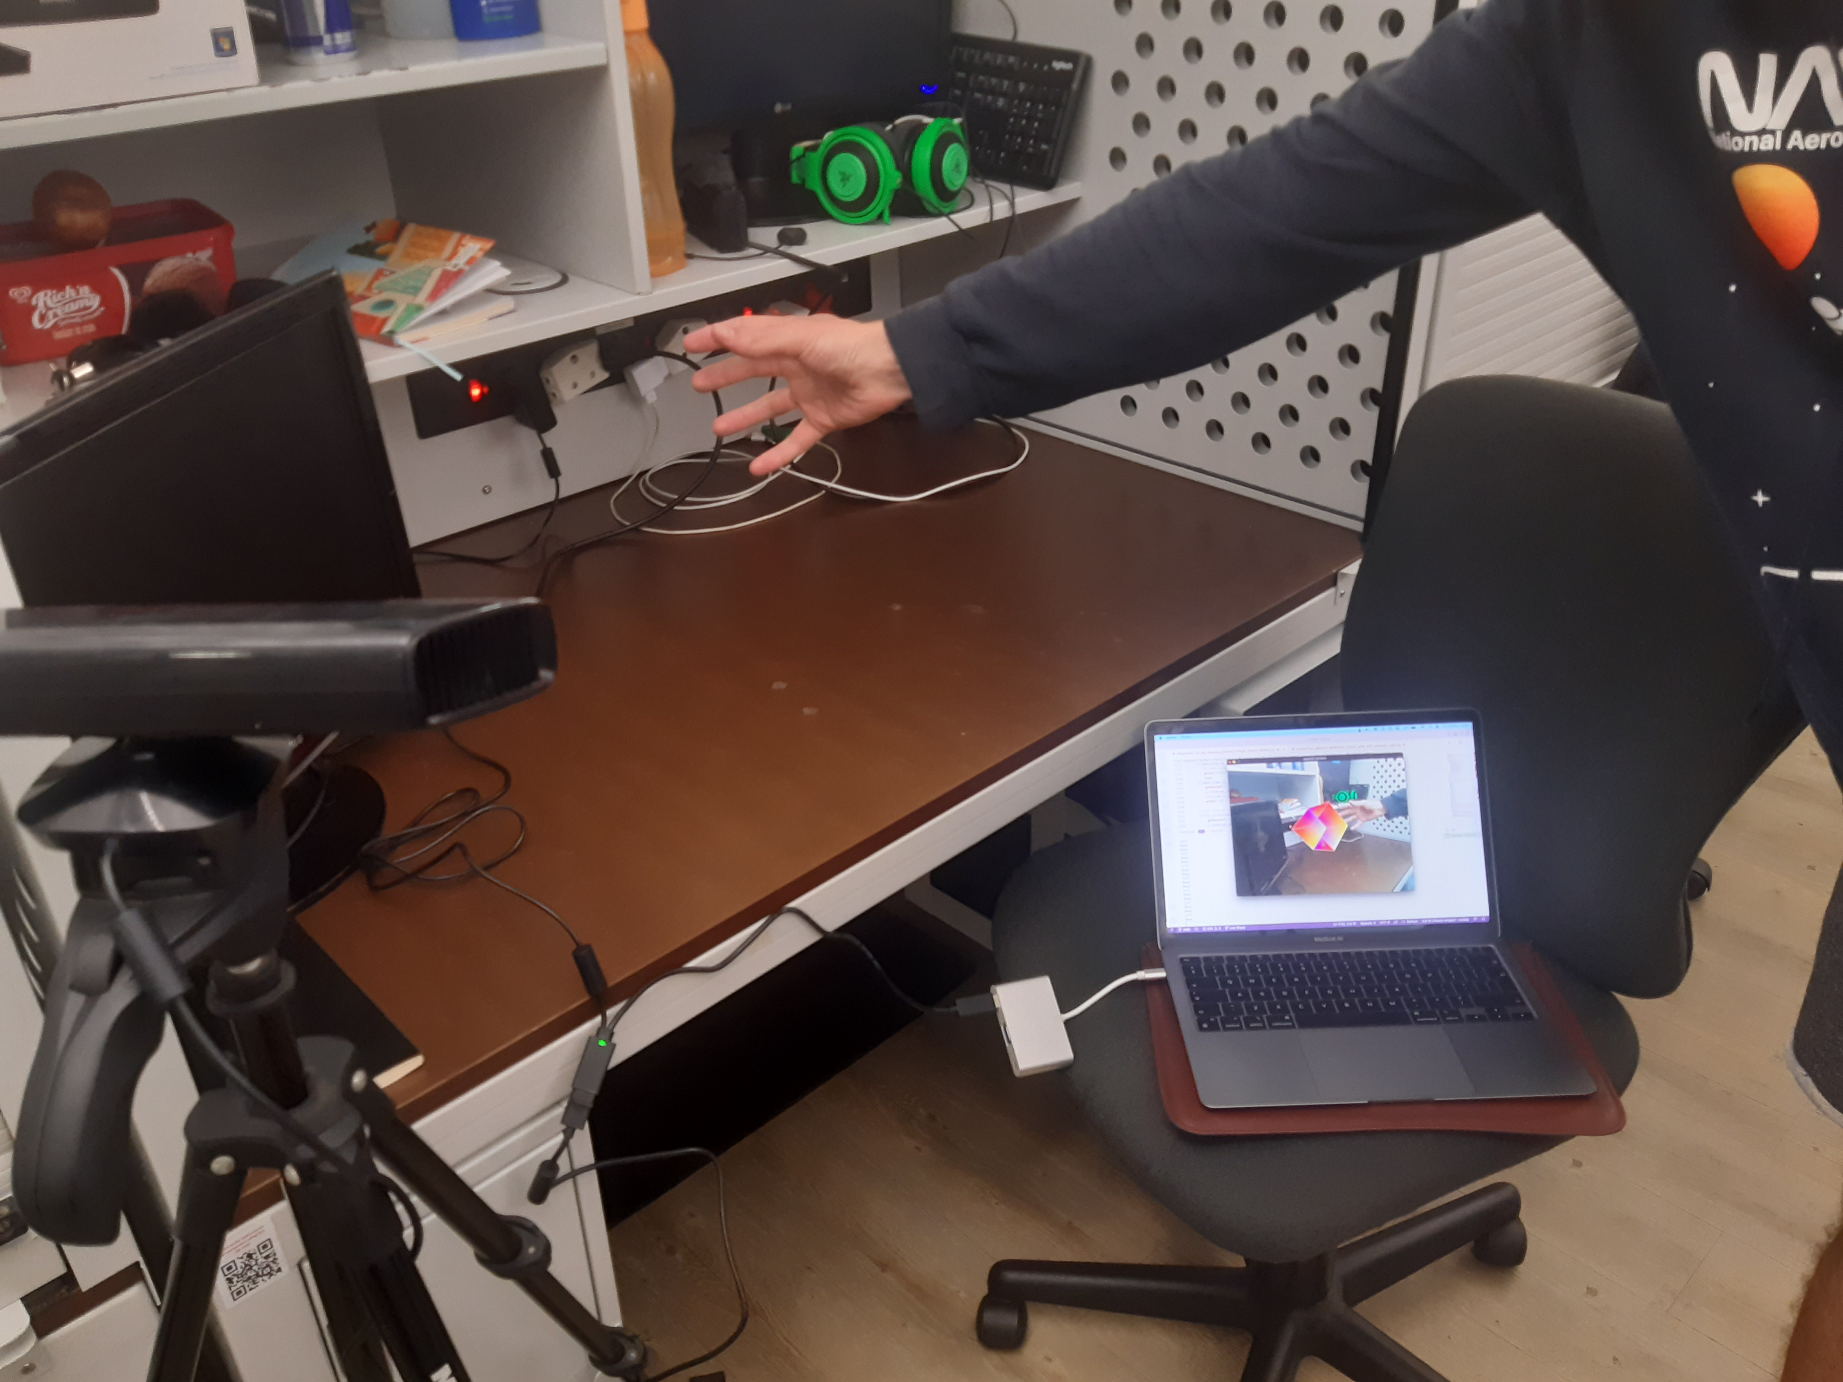
Real-time hand gesture control of a virtual object in augmented reality

